Slide 1
PARALLEL JACOBI ALGORITHM
Rayan Alsemmeri
Amseena Mansoor

Slide 2
LINEAR SYSTEMS
Jacobi method is used to solve linear systems of the form Ax=b, where A is the square and invertible.
Recall that if A is invertible there is unique solution

Slide 3
METHODS SOLVE LINEAR SYSTEMS
Direct solvers
Gaussian elimination
LU decomposition
Iterative solvers
Stationary iterative solvers
Jacobi
Gauss-Seidel
Successive over-relaxation
Non-Stationary iterative methods
Generalized minimum residual (GMRES)
Conjugate gradient

Slide 4
Direct vs Iterative
Direct Method
-Dense systems
Gaussian Eliminations
Changes sparsity pattern -introduces non-zero entries which were originally zero
Iterative Method
Sparse systems(usually come in very large size)
Jacobi method:
Main source is numerical approximation of PDE
-

Slide 5
ITERATIVE METHODS
Starts with an initial approximation for the solution vector (x⁰)
At each iteration algorithm updates the x vector by using the sytem Ax=b
During the iterations coefficient A, matrix is not changed so sparsity is preserved
Each iteration involves a matrix-vector product
If A is sparse this product is efficiently done

Slide 6
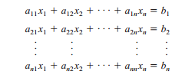
Jacobi Algorithm
The first iterative technique is called the Jacobi method. This method makes two assumptions: First, the system given by
has a unique solution

Slide 7
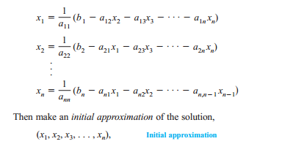
Jacobi Method
The coefficient matrix A has no zeros on its main diagonal. If any of the diagonal entries are zero, then rows or columns must be interchanged to obtain a coefficient matrix that has nonzero entries on the main diagonal.
To begin the Jacobi method, solve the first equation for x1, the second equation for x2
and so on, as follows.

Slide 8


How to apply the jacobi method
Continue the iterations until two successive approximations are identical when rounded to
three significant digits.
To begin, write the system in the form

Slide 9
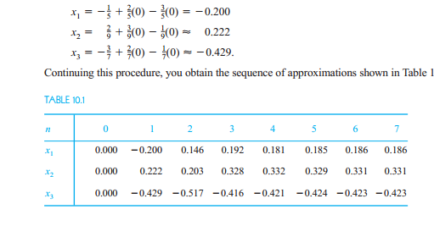
Example of Jacobi

Slide 10
Stopping Criteria
Difference between two consecutive approximations component wise is less than some tolerance
There exist other ways of computing distance between two vectors, using norms

Slide 11
Jacobi iteration

Slide 12
SEQUENTIAL JACOBI ALGORITHM
D is diagonal matrix
L is lower triangular matrix
U is upper triangular matrix

Slide 13
Pseudo Code for Jacobi
X-new //new approximation
X-old//previous approximation
Tol//given(specified by the number)
Counter=0//counts number of iterations
Iter-max//maximum number of iterations(specified by problem)
While(diff>tol &&counter<iter_max)
{
X_new=D⁻¹(b-(L+u)X_old);
Diff=X_new-X_old;
X_old=X_new;
Counter=counter+1;
}

Slide 14
Does Jacobi Always Converge?
As k→∞,under what conditions on A the sequence {x^{k}} converges to the solution vector
For the same A matrix, one method may converge while the other may diverge

Slide 15
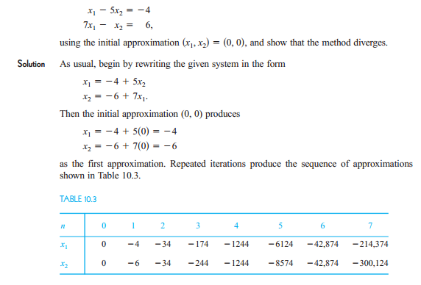
Example of Divergence
Notes:
Explain how to make it strictly diagonally dominant matrix

Slide 16
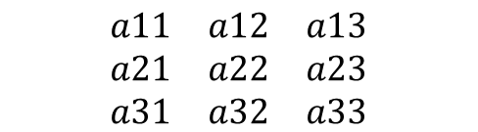



How to guarantee the convergence
The coefficient matrix of A should be strictly diagonally dominant matrix
If the coefficient matrix of A is not strictly diagonally dominant matrix we can exchange the rows to keep it strictly diagonally dominant
$\left|a11\right|>\left|a12\right|+\left|a13\right|$+……. $\left|a1n\right|$
$$\begin{matrix}a11 & a12 & a13 \\ a21 & a22 & a23 \\ a31 & a32 & a33\end{matrix}$$
$\left|a22\right|>\left|a21\right|+\left|a23\right|$+……. $\left|a2n\right|$
$\left|a31\right|>\left|a32\right|+\left|a33\right|$+……. $\left|a3n\right|$
Notes:
Give an example in the board about not strictly diagonally dominant matrix and how to exchange the rows

Slide 17
Theorem
If A is strictly diagonally dominant, then the system of linear equations given by, has a unique solution to which the Jacobi method will converge for any initial approximation

Slide 18
Parallel Implementations of Jacobi Algorithm
X^{k+1}
D⁻¹
b
L+U
X^{K}
-

Slide 19
Parallel Jacobi Algorithm
Row wise Matrix Vector multiplication
Shared-memory parallelization very straightforward
Consider distributed memory machine using MPI

Slide 20
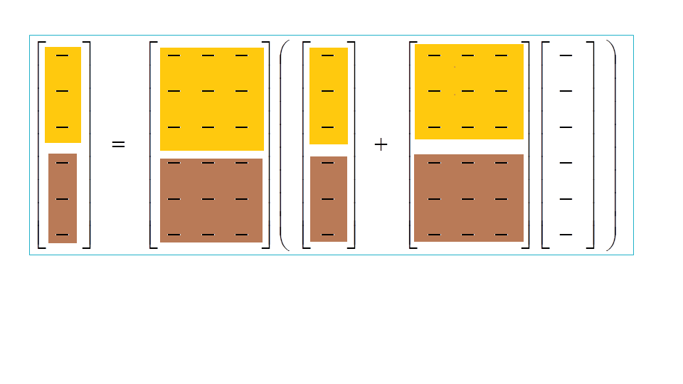
Row wise with shared memory
X^{k+1}
D⁻¹
b
L+U
X^{K}
-

Slide 21
Pseudo code of Jacobi distributed memory systems
Distribute D⁻¹,b,L+U row wise at each node
Distribute initial guess X⁰ to all nodes
Perform Jacobi iterative at each node to compute corresponding parts
Broadcast all parts of new approximation to the master process(Let us say p=0)
Distribute new approximation to all nodes row wise
Repeat from 3

Slide 22
Complexity
The most expensive part is matrix vector multiplication which is of order O(n²)
But, with p-threads we have the complexity O(n²/p)

Slide 23
Conclusion
Easier implementation in shared memory
Various Distribution schemes for distributed system(block-cycle)
Modifications of Jacobi Method
-Gauss Seidel & Successive Over Relaxation(SOR)

Slide 24
References
http://www.amazon.com/Parallel-Programming-Multicore-Cluster-Systems/dp/364204817X
http://college.cengage.com/mathematics/larson/elementary_linear/5e/students/ch08-10/chap_10_2.pdf
www.eee.metu.edu.tr/~skoc/ee443/iterative_methods.ppt

Slide 25
Thank You!!!!!!

